Slide 1
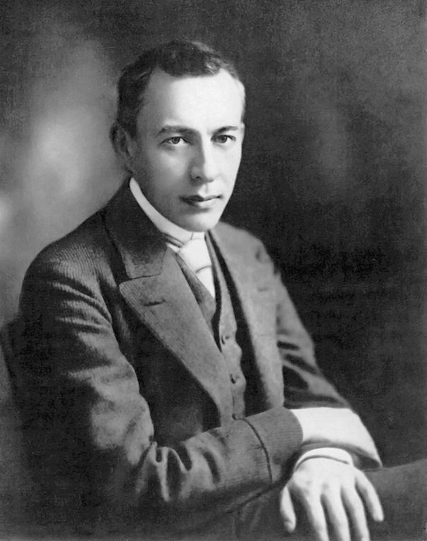

Sergei Vasilyevich Rachmaninoff
(1873-1943)
Piano Concerto No. 2 in C minor, Op. 18 – 2. Adagio Sostenuto
Sergei Vasilyevich Rachmaninoff was a Russian composer, virtuoso pianist and conductor.
Piano Concerto No. 2 was finished in April 1901. The piece earned the composer a Glinka Award, the first of five awarded to him throughout his life, and a 500-rouble prize in 1904.
Wednesday, 31 July 2019

