Slide 1
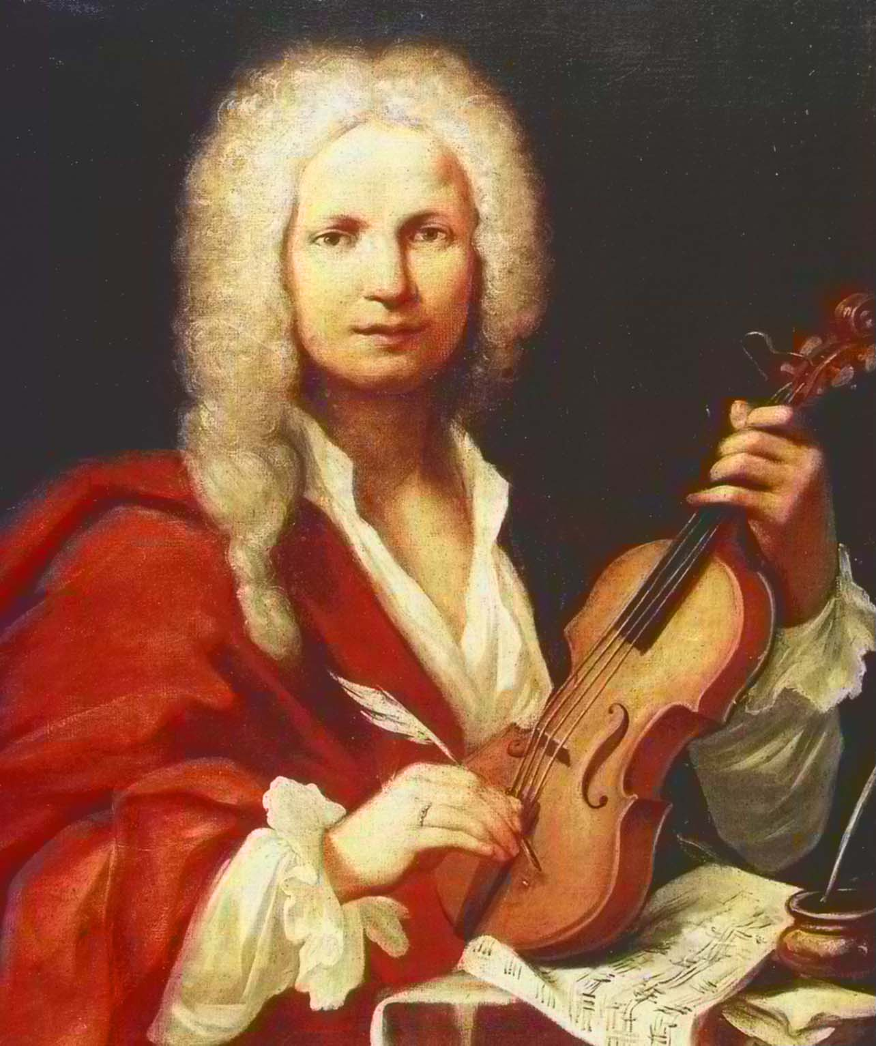

Antonio Vivaldi
(1678-1741)
Concerto No. 3 in F major, Op. 8, RV 293, "Autumn" (L'autunno)
Antonio Lucio Vivaldi was an Italian composer, virtuoso violinist, teacher, and priest. Born in Venice, he is regarded as one of the greatest Baroque composers, and his influence during his lifetime was widespread across Europe.
He composed many instrumental concertos, for the violin and a variety of other instruments, as well as sacred choral works and more than forty operas. His best-known work is a series of violin concertos known as the Four Seasons.
Wednesday, 31 July 2019

