Slide 1
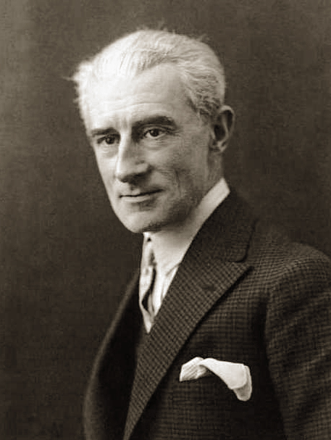

Maurice Ravel
(1875-1937)
Pavane
Joseph Maurice Ravel was a French composer, pianist and conductor. In the 1920s and 1930s Ravel was internationally regarded as France's greatest living composer.
A slow and painstaking worker, Ravel composed fewer pieces than many of his contemporaries. Many of his works exist in two versions: first, a piano score and later an orchestration.
Pavane is a piece for solo piano composed in 1899 while Ravel was studying composition.
Wednesday, 31 July 2019

