Slide 1
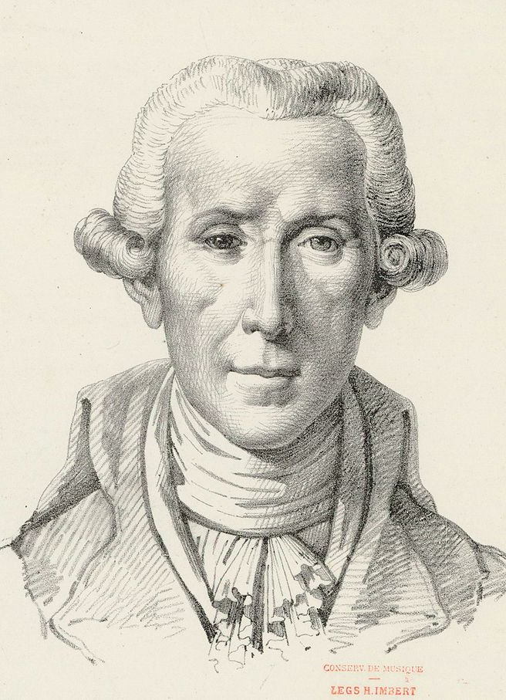

Luigi Boccherini
(1743-1805)
Op. 11, No. 5: String Quintet in E major, Minuet
Ridolfo Luigi Boccherini was an Italian composer and cellist.
The String Quintet in E major was written in 1771 and published in 1775. Being one of his most famous works, the quintet is famous for this minuet which is most-often played as a standalone piece outside of the context of the full quintet.
Wednesday, 31 July 2019

