Slide 1
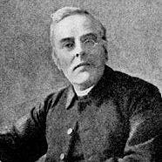

John Ellerton
(1826-1893)
St. Clement
The Day Thou Gavest, Lord, Is Ended, is a hymn which has often topped the charts in the BBC's Songs of Praise poll.
The work of a Cheshire vicar, John Ellerton, who is said to have written it in 1870, as he went for his nightly walk.
Queen Victoria selected it as the hymn for her Diamond Jubilee in 1897. It was sung exactly a century later when Britain handed control of Hong Kong to China in 1997.
Wednesday, 31 July 2019

