Slide 1
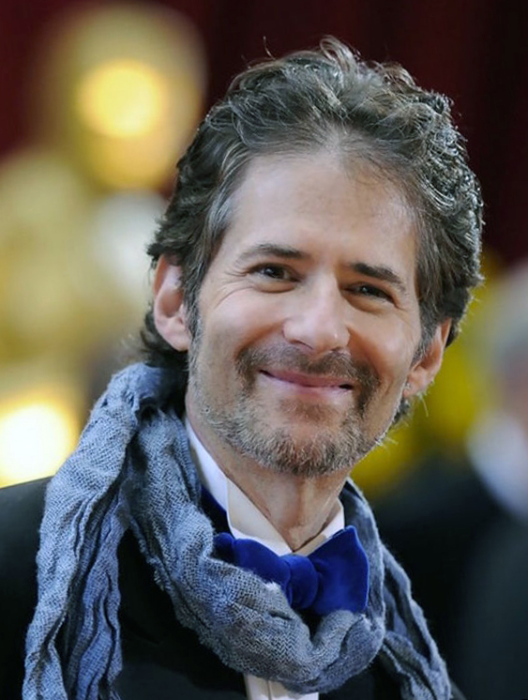

James Horner
(1953-2015)
For The Love Of A Princess
James Roy Horner was an American composer, conductor and orchestrator of over 100 film scores. He was known his frequent use of themes linked to Celtic music.
His score for Titanic is the best-selling orchestral film soundtrack of all time.
This piece of music is from the 1995 film, Braveheart.
Wednesday, 31 July 2019

