Slide 1
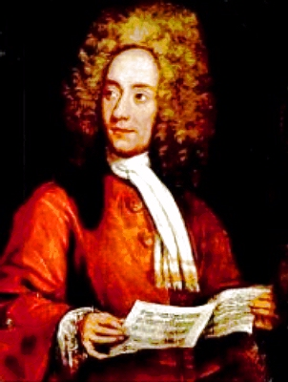

Tomaso Albinoni
(1671-1751)
Adagio in G minor, arranged by Remo Giazotto
Tomaso Giovanni Albinoni was an Italian Baroque composer.
This composition is often referred to as "Albinoni's Adagio" or "Adagio in G minor by Albinoni, arranged by Giazotto". The ascription to Albinoni rests upon Giazotto's discovery of a manuscript fragment from a slow second movement of an otherwise unknown Albinoni trio sonata. Giazotto then completed the work.
Wednesday, 31 July 2019

