Slide 1
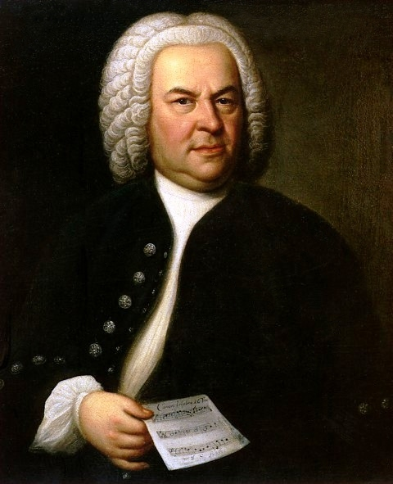

Johann Sebastian Bach
(1685-1750)
Suite No. 3 in D major
2, Air
Johann Sebastian Bach was a German composer and musician. He is known for writing over 1000 instrumental compositions and for vocal music.
Many of his family were also very good composers, such as his uncle and several of his sons (for example, C.P.E. Bach). In fact, you could say that the Bach family is the greatest musical family the world has ever known.
Wednesday, 31 July 2019

