Slide 1
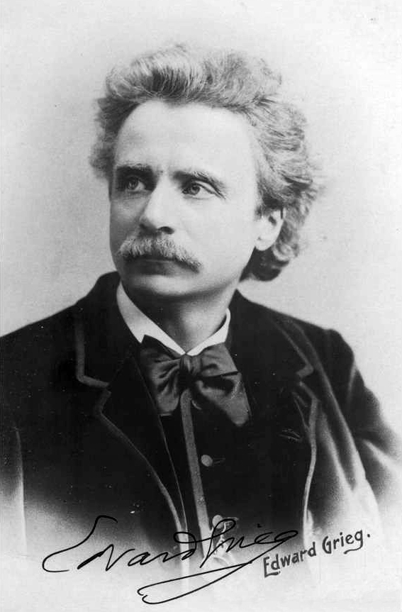

Edvard Grieg
(1843-1907)
Peer Gynt: 1, The Morning
Edvard Hagerup Grieg was a Norwegian composer and pianist. His use and development of Norwegian folk music in his own compositions brought the music of Norway to international ears, as well as helping to develop a national identity.
Grieg is the most celebrated person from the city of Bergen, with many buildings named after him and statues of him around the town.
In 1876, Grieg was asked write some music for a performance of a play about the Norwegian fairy tale, Peer Gynt.
Wednesday, 31 July 2019

