Slide 1
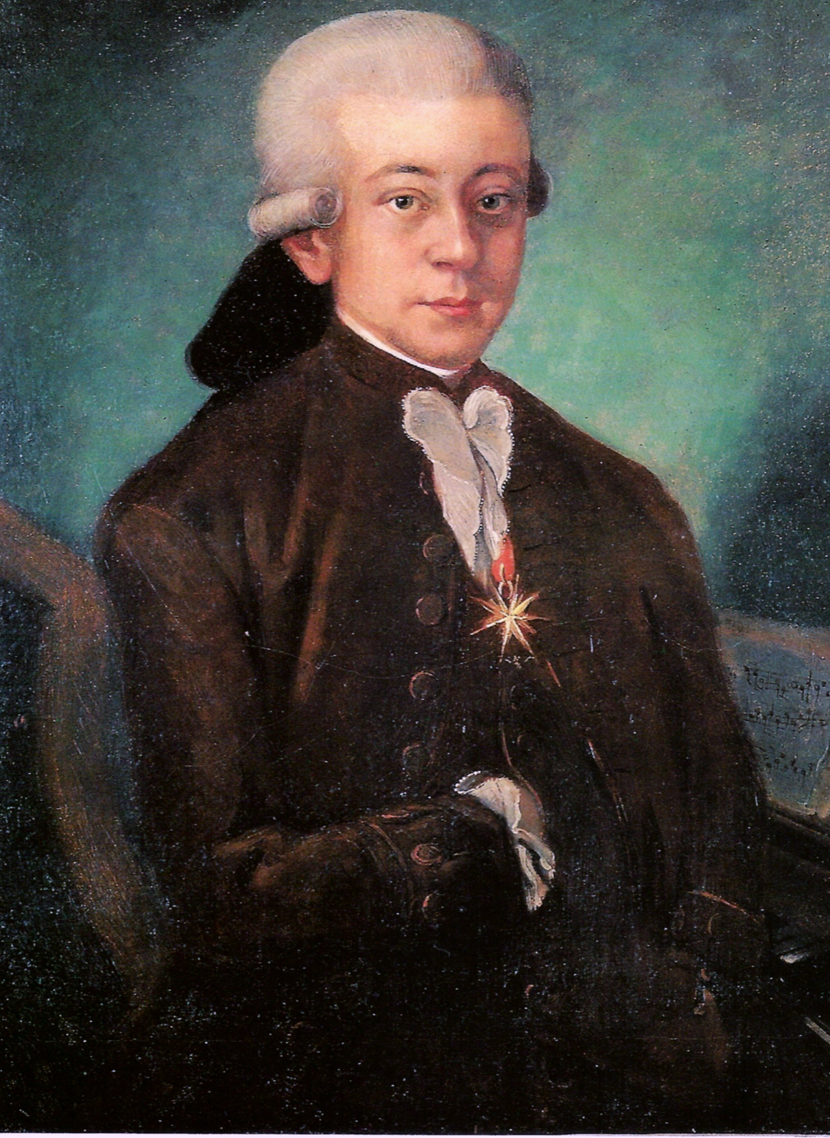

Wolfgang Amadeus Mozart
(1756-1791)
KV 261: Adagio for Violin and Orchestra in E
Wolfgang Amadeus Mozart, baptised as Johannes Chrysostomus Wolfgangus Theophilus Mozart, was a prolific and influential composer.
The Adagio in E for Violin and Orchestra, K. 261, was composed in 1776. It was a replacement movement for the original slow movement of his Violin Concerto No. 5 in A. It is believed that Mozart wrote it specifically for the violinist Antonio Brunetti, who complained that the original was not good enough.
Wednesday, 14 August 2019

