Slide 1
Careers

Slide 2

Jobs and Careers
When you work to earn money you have a job.
Some people keep doing the same kinds of job for a long time, they get better at it and get more responsibilities. This is called a career.

Slide 3

Know yourself
Though we always talk about what you would like to be when you grow up, you actually don’t have to decide this until you are adults.
The most important preparation you can do for your future is to know what your talents are and what you enjoy doing.
This Photo by Unknown Author is licensed under CC BY-SA-NC

Slide 4

Education Journey
When you are at secondary school you have to choose which subjects to study for GCSEs at the age of 14.
This is why it is important to know which things you enjoy doing and are good at.
This Photo by Unknown Author is licensed under CC BY-ND

Slide 5
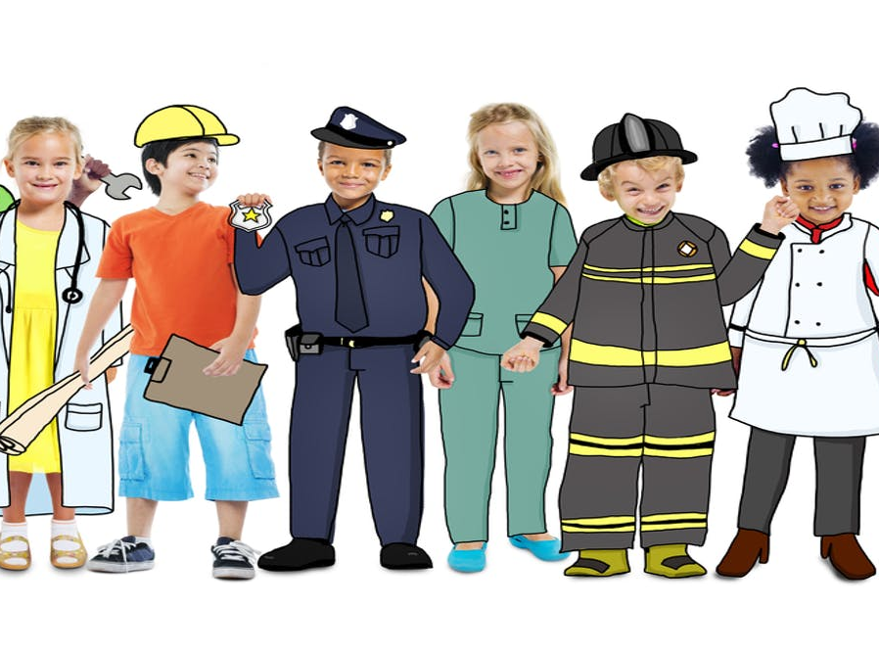
Sectors
Different kinds of jobs are grouped into sectors. We introduce these in school all the time.
An example of a sector is Health and Social Care, which has lots of jobs in it such as nurses, radiologists, speech therapists and social workers.
Can you name a sector?
This Photo by Unknown Author is licensed under CC BY-ND

Slide 6

Skills
At Heatherlands we plan activities to help you develop skills that are really important for school life and beyond.
What skills do we develop and how?

Slide 7
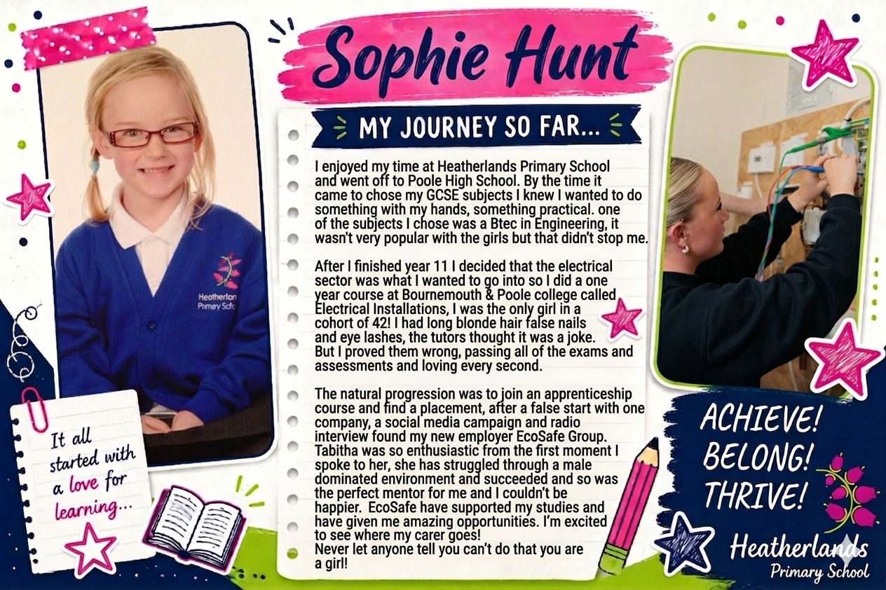
The Heatherlands Alumni - the former students of a school, college, or university. The term comes from the Latin word alere, meaning "to nourish," and originally referred to those who had been "nurtured" by an educational institution.

Slide 8
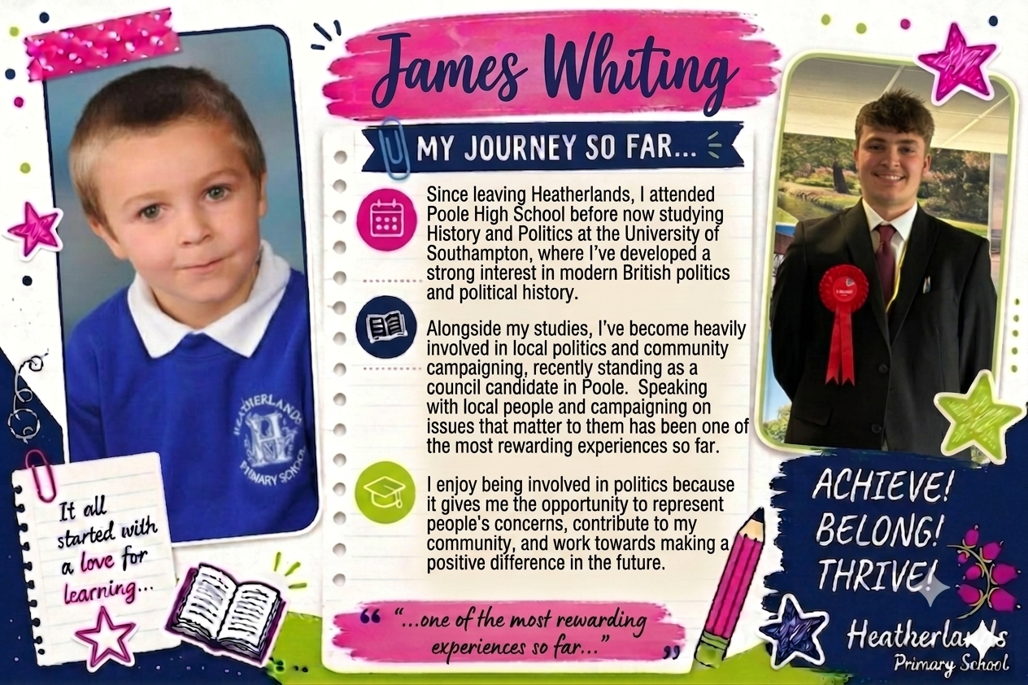

Slide 9
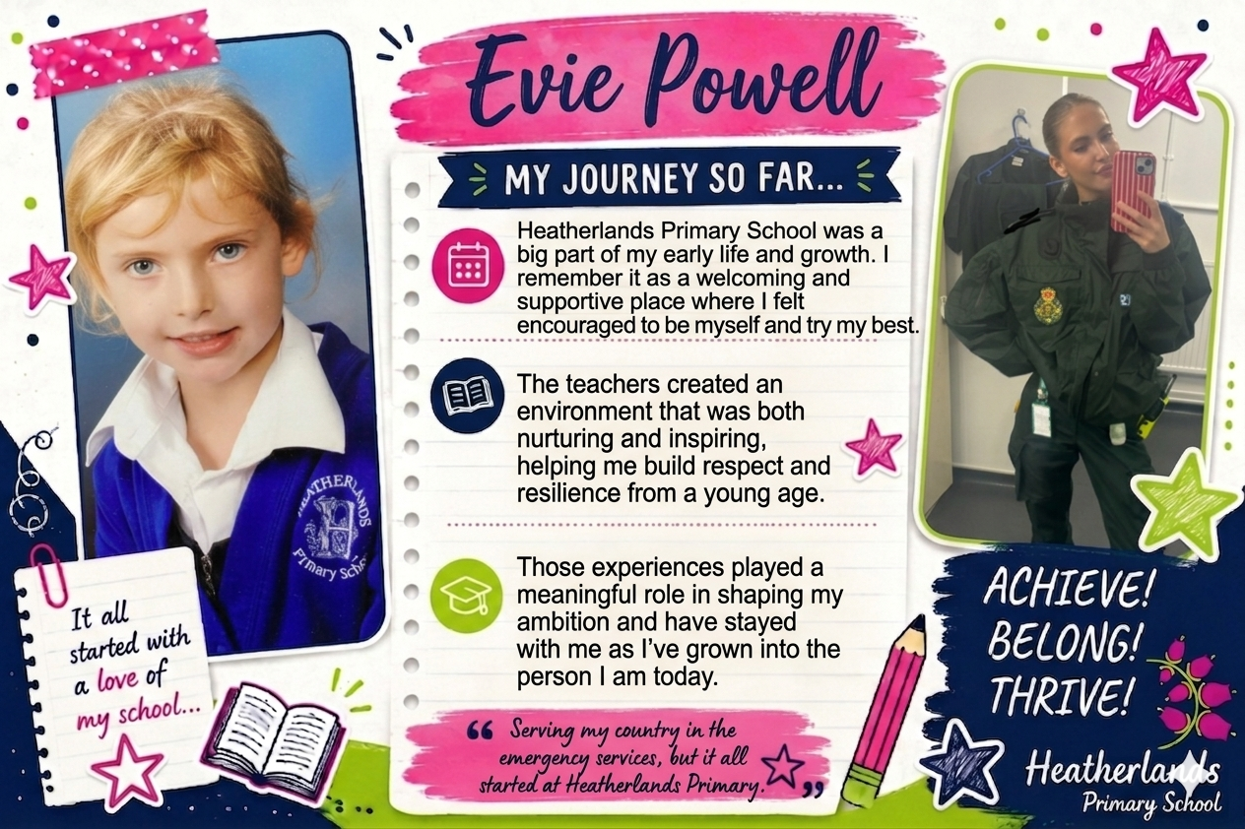

Slide 10
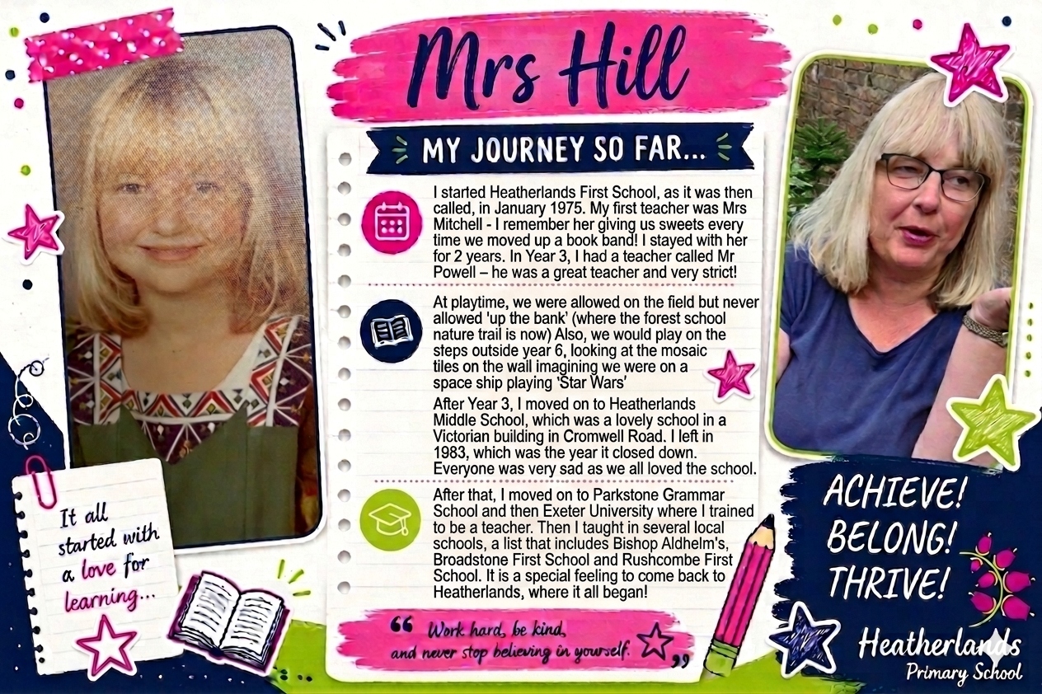

Slide 11
Our special visitors…

